Slide 1
IBM University Engagement Project Submission
“Exploring the Power of Agentic AI with IBM Granite and LangFlow”

Slide 2

Project Tile – AmulyaDhara AI
Domain of Project – Economic Development
Student Name | Recent Passport Photo | Email ID | Mobile number [WhatsApp]
Meet Rathod |  | meetbhaibakulbhai@gmail.com | 8401363841

Slide 3
Problem Statement - : AI-Based Dairy Cooperative Supply Chain Optimization Platform
The Challenge
Gujarat's dairy cooperatives (Amul model) face challenges in milk collection route efficiency, fodder cost volatility, and matching milk supply with fluctuating demand, impacting profitability for millions of dairy farmers.
The Objective
Develop Agentic AI solutions that optimize milk collection logistics, forecast fodder prices, and align production planning with cooperative and market demand.
Suggested AI Agents
• Milk Collection Route Optimization Agent
• Fodder Price Forecasting Agent
• Demand-Supply Matching Agent
• Farmer Payment & Transparency Agent
• Cooperative Performance Dashboard Agent

Slide 4
Proposed Solution - "Developing an AI-driven platform to optimize dairy cooperative supply chains, significantly reducing milk spoilage and operational costs."
This proposed solution is a multi-agent AI platform built using LangFlow, IBM watsonx.ai, and Granite Models to deliver optimized logistics and real-time inventory management. It effectively tackles industry challenges like milk spoilage, route inefficiencies, and demand forecasting through an intelligent, modular architecture.
A Retrieval-Augmented Generation pipeline fetches accurate market, cooperative, and environmental data. Stored securely in a vector database, this enables the system to rapidly retrieve and summarize critical logistical details, such as weather impacts and traffic patterns, using Granite models.
The system relies on four agents:
Demand Forecasting Agent prevents shortages by predicting supply variations using historical trends.
Route Optimization Agent creates dynamic, cost-effective distribution routes to minimize fuel consumption.
Inventory Quality Agent monitors perishable milk, providing preventive spoilage alerts.
Farmer Communication Agent enables voice or text yield logging and delivers schedule updates instantly.
A Streamlit dashboard clearly visualizes daily collection metrics and closely tracks waste-reduction progress. LangFlow orchestrates all workflows, watsonx.ai ensures scalable deployment and strict governance, while Granite models power automated decision-making.
Overall, this intelligent assistant promotes highly sustainable dairy operations through predictive insights, efficient routing, and exceptional inventory control, ultimately maximizing both cooperative profitability and long-term success.

Slide 5
Technology Used
Langflow platform -For designing and orchestrating multi-agent workflows visually
IBM Granite model - for eg – ibm-granite-3-2-8b – For natural language understanding, reasoning, and personalization
IBM Cloud – It provides the infrastructure to build, deploy, and scale the Nutrition Agent efficiently. IBM Cloud enables a reliable, secure, and scalable environment for deploying the Nutrition Agent.
RAG– RAG to fetch real data first, then generate intelligent answers, making the Nutrition Agent more trustworthy and effective.
IBM Watsonx.ai - For model deployment, embeddings, and AI governance
Vector Database (FAISS/Chroma) – For RAG-based nutritional data retrieval

Slide 6
Langflow component Used -
1) Chat Input – Interface where users enter their queries, preferences, or meal details (text/voice/image).
2) IBM watsonx AI Agent - Processes user input using Granite models to generate personalized nutrition insights and recommendations.
3) Name of IBM Granite model - Granite-4.0-8B-Instruct → Fast, efficient for real-time diet recommendations
4) Chat output -Displays AI-generated responses such as diet plans, nutritional analysis, and health suggestions.
5) File component - Stores and retrieves user data, meal logs, and nutritional datasets for analysis and tracking.

Slide 7

Role of Agentic AI in the solution
Role of Agentic AI in Nutrition Agent
Agentic AI enables the Nutrition Agent to function as an intelligent, autonomous system rather than a simple chatbot. Using IBM watsonx.ai and IBM Granite models, it coordinates multiple specialized agents to deliver personalized nutrition guidance.
Each agent performs a specific role—such as retrieving nutritional data, generating diet plans, providing health advice, and analyzing food logs—while working collaboratively. This multi-agent approach ensures efficient task execution and accurate results.
Agentic AI also brings context awareness, understanding user details like age, health conditions, and fitness goals to generate tailored recommendations. It supports real-time adaptation, continuously updating suggestions based on user inputs like daily meals.
Additionally, agents communicate with each other, enabling better decision-making and improved outcomes.
Overall, Agentic AI makes the system proactive, personalized, and goal-driven, acting like a smart digital nutritionist that helps users maintain a healthy lifestyle.

Slide 8
Novelty and Uniqueness
The proposed Nutrition Agent stands out by combining Agentic AI, RAG, and personalization into a single intelligent system.
Multi-Agent Intelligence – Instead of a single chatbot, multiple specialized agents collaborate to deliver accurate and context-aware nutrition guidance.
RAG-Based Accuracy – Integrates real-time data retrieval with AI generation, reducing misinformation and ensuring trustworthy recommendations.
Hyper-Personalization – Tailors diet plans based on health conditions, cultural preferences, and fitness goals.
Real-Time Feedback Loop – Continuously adapts recommendations based on daily food logs and user behavior.
Multi-Modal Input – Supports text, voice, and image-based meal tracking for better usability.
Preventive Healthcare Focus – Goes beyond diet planning to provide disease-specific nutrition advice.
Scalable & Enterprise-Ready – Built on IBM watsonx.ai with IBM Granite models, ensuring reliability and governance.
This makes the solution a smart, adaptive, and proactive digital nutritionist, not just a static diet recommendation tool.

Slide 9
Git Hub Link
GITHUB REPOSITORY LINK :- https://github.com/meetbhaibakulbhai-boop/me
GITHUB UPLOADED WEBSITE LINK:- https://meetbhaibakulbhai-boop.github.io/me/
·
·
·

Slide 10
Future Scope
Integration with IoT & Sensor Networks – The system can be expanded with a wider network of AI-enabled IoT temperature sensors, GPS trackers, and smart scales across dairy cooperative boundaries. This will enable more accurate, real-time tracking of milk quality and transport vehicles across a larger area, improving early detection of spoilage risks and logistical delays.
2. Multilingual Voice-Based Alerts – Adding voice-enabled, multilingual alert delivery (Gujarati, Hindi, English) will make system notifications more accessible to dairy farmers, especially in rural areas with low literacy or limited smartphone access, ensuring faster responses to collection schedules and pricing updates.
·
·
·

Slide 11
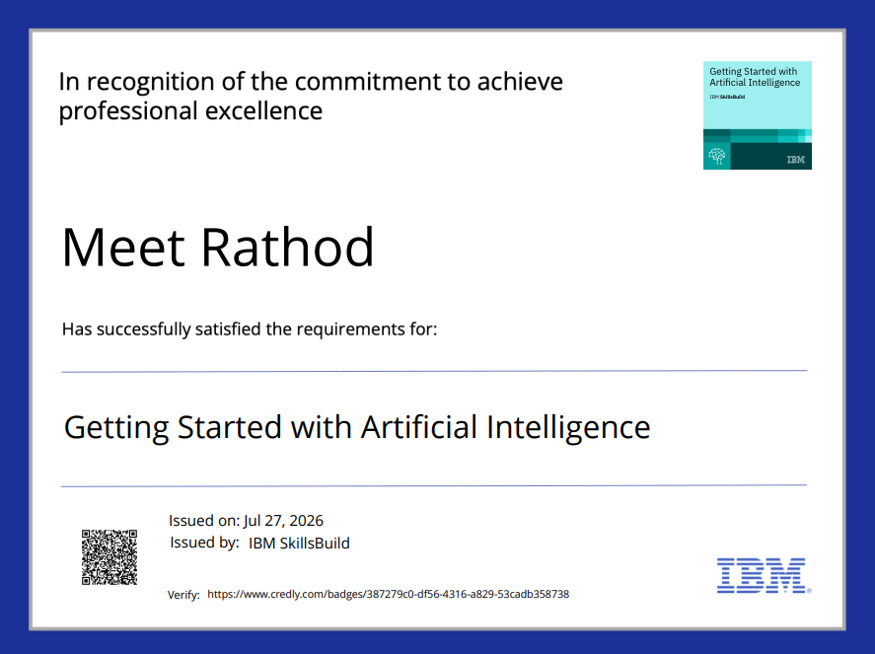
Certificates Earned:
Please add your credly certificate

Slide 12
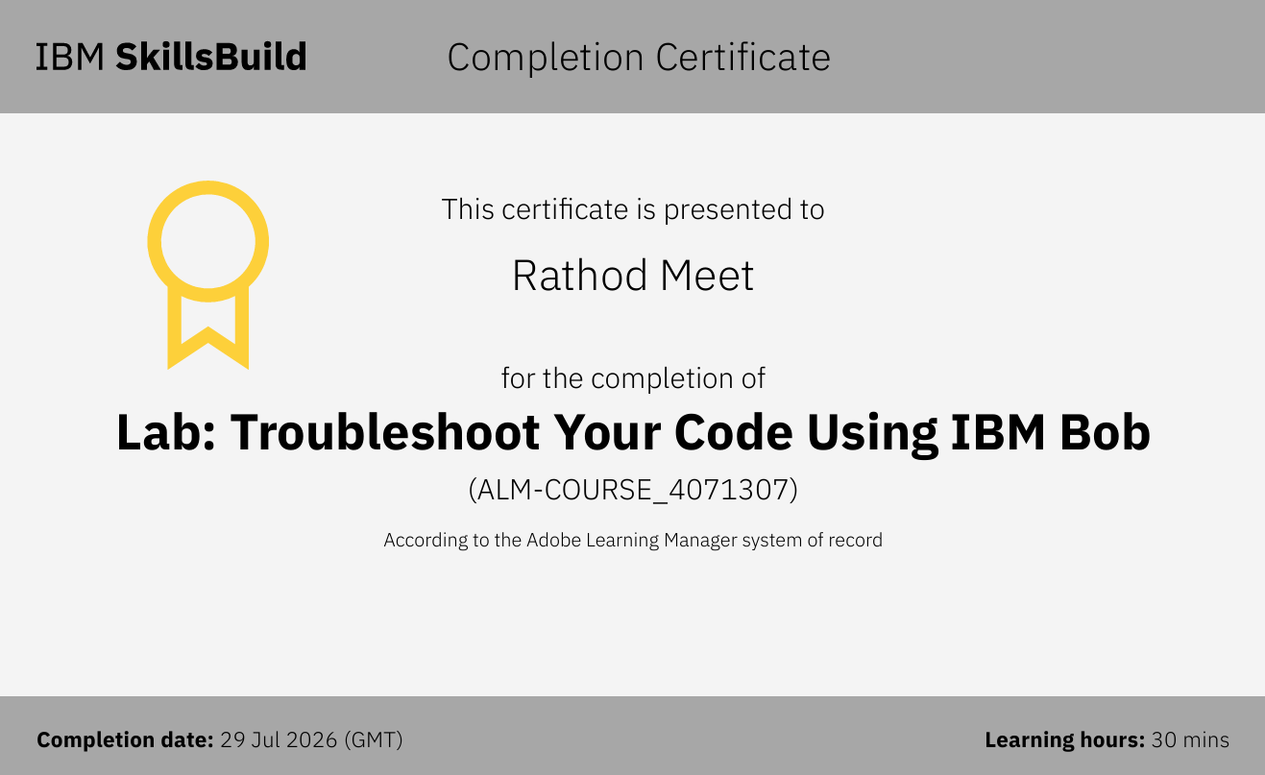
Certificates Earned:​
Add your IBM BOB Certificate

Slide 13


